Slide 2
Unit 6: Docker (8hrs)
Introduction to Real World Transportation Challenges
Docker Introduction
Architecture of Docker
Docker Containers: Creation, Share and Publish
Docker Networking: Network Types, Docker Compose
Docker Swarm: Introduction, Creating and Scaling Docker Bundles

Slide 3
Once upon a time
Somewhere in a bustling software company, InnovateTechNepal, a team of developers worked on a revolutionary new application.
The company had a big problem: their brilliant developers and diligent operations team couldn’t seem to get along.

Slide 4
The CHAOS
The developers worked hard on building applications, ensuring everything ran perfectly on their laptops. But every time they handed their code to the operations team for deployment, disaster struck:
"It works on my machine!": A phrase often heard when the app works locally but fails in the production environment. Developers blamed the servers, and operations blamed the code.
Environment Differences: The development team used one version of a library, but the production server had a different one.

Slide 5
The PROBLEM
Tedious Setup: The operations team spent hours or even days manually installing software, configuring servers, and debugging strange errors caused by tiny differences in setup.
Scaling Nightmare: When the app gained popularity, the team tried to scale it to handle more users. But, setting up additional servers with the exact same environment was painstakingly slow and error-prone.

Slide 6
Enter Docker : The Savior
One day, during a heated meeting, an engineer named Dammar (yes, Dammar again) introduced a tool called Docker.
“Imagine,” Dammar said, “if we could package the application and all its dependencies into a single container, like a box.
Wherever we take the box, the app works perfectly whether on our laptops, testing servers, or the production environment.”
The team was skeptical but decided to give it a try.

Slide 7
The Transformation
Dammar helped the team Dockerize their application. Here’s what happened:
Building Containers:
The developers created a Dockerfile, specifying everything the app needed - libraries, runtime, and configurations. Using this, they built a container that worked the same way everywhere.

Slide 8
The Transformation
Consistent Environments:
No more "It works on my machine." The container ran the application the same way on any system that supported Docker, solving the environment mismatch issues.
Easy Deployment:
Instead of spending hours configuring servers, the operations team just ran a simple command:
docker run app-container

Slide 9
The Transformation
Scalability:
When the app’s traffic increased, scaling became effortless. The operations team spun up multiple instances of the container in seconds.
Team Harmony:
Developers and operations finally spoke the same language. The collaboration improved, and they started delivering new features faster.

Slide 10
The HAPPY ENDING
Soon, the chaos faded away:
Docker became the team’s magic tool - a portable, consistent environment that bridged the gap between development and production.
As InnovateTechNepal Inc.’s applications grew more complex, Docker also helped them adopt a microservices architecture, making their systems more modular and scalable.
And so, with Docker, the team transformed their workflows, delivering software with confidence and ease. From that day on, InnovateTechNepal Inc. became a shining example of DevOps excellence in Nepal.

Slide 11
Docker
Docker is a set of Platforms as a service (PaaS) products that use Operating system-level virtualization to deliver software in packages.
Docker is a containerization platform that allows developers to package applications and their dependencies into containers.
Containers are lightweight and portable.
Containers are consistent across different environments, making them an essential tool for modern software development.
This simplifies application deployment across different environments.

Slide 12
Docker Benefits
Portability: Containers run consistently across development, testing, and production environments.
Efficiency: Containers share the host OS kernel, making them lightweight compared to virtual machines (VMs).
Speed: Quick to start, stop, and deploy compared to VMs.
Scalability: Ideal for microservices architectures, allowing easy scaling of services.

Slide 13
Docker
Developers can create isolated environments for testing applications.
Integrates with tools like Jenkins to automate builds, testing, and deployments.
Docker containers allow individual services to run independently, enabling scalability.
Cloud providers like AWS, Azure, and Google Cloud integrate Docker for scaling containerized applications.

Slide 14
Concepts in Docker
Images
Blueprint for containers; includes app code, runtime, libraries, and dependencies.
Example: A Python image contains Python runtime and libraries.
Containers
Running instances of images.
Example: Running a web server container using an Nginx image.

Slide 15
Concepts in Docker
Dockerfile
Script with instructions to build an image.
Example:
FROM python:3.9
COPY . /app
WORKDIR /app
RUN pip install -r requirements.txt
CMD ["python", "app.py"]

Slide 16
Concepts in Docker
Docker Engine
The runtime that builds and runs containers.
Docker Hub:
A cloud-based registry to store and share Docker images.
Volumes:
Persist data generated by containers outside the container lifecycle.
Example: Storing a database in a volume so it’s not deleted when a container restarts.

Slide 17
Commands in Docker
docker pull <image>: Download an image from Docker Hub.
docker run <image>: Create and run a container.
docker build -t <name> .: Build an image using a Dockerfile.
docker ps: List running containers.
docker stop <container>: Stop a running container.
docker rm <container>: Remove a stopped container.

Slide 18
Architecture of Docker
Docker's architecture is designed around the client-server model.
Lightweight containers run on top of a host operating system.
This enables developers to build, ship, and run applications in isolated environments.

Slide 19
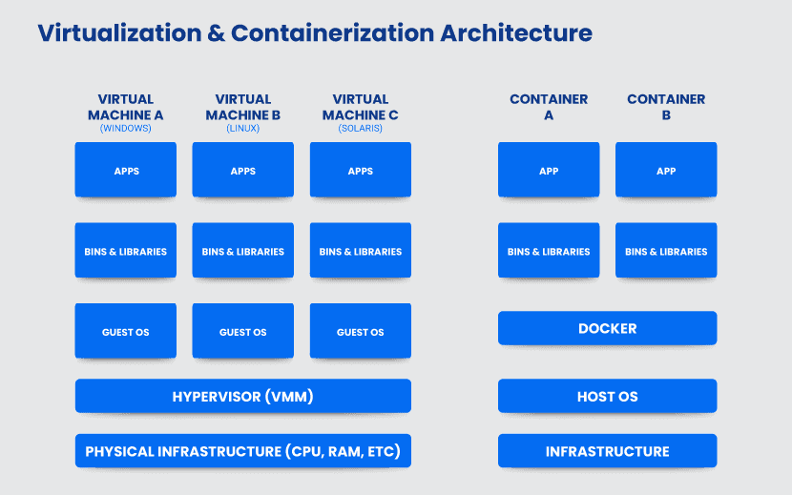

Slide 20
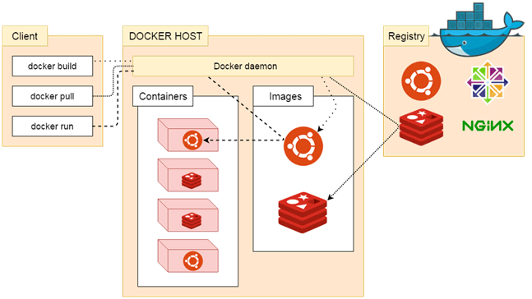
Architecture of Docker

Slide 21
Architecture of Docker
Docker uses a client-server architecture.
The Docker client talks to the Docker daemon, which does the heavy lifting of building, running, and distributing the Docker containers.
The Docker client and daemon can run on the same system, or you can connect a Docker client to a remote Docker daemon.
Another Docker client is Docker Compose, that lets you work with applications consisting of a set of containers.

Slide 22
Docker Daemon
The Docker daemon (dockerd) listens for Docker API requests and manages Docker objects such as images, containers, networks, and volumes.
A daemon can also communicate with other daemons to manage Docker services.

Slide 23
Docker Client
The Docker client (docker) is the primary way that many Docker users interact with Docker.
When you use commands such as docker run, the client sends these commands to dockerd, which carries them out.
The docker command uses the Docker API.
The Docker client can communicate with more than one daemon.
Docker daemon receives these commands from the docker client through command and REST API's request.

Slide 24
Docker Client
Docker Client uses Command Line Interface (CLI) to run the following commands:
docker build
docker pull
docker run

Slide 25
Docker Host
Docker Host provides an environment for executing and running applications.
It contains the docker daemon, images, containers, networks, and storage.

Slide 26
Docker Registry
A Docker registry manages and stores Docker images.
Docker Hub is a public registry that anyone can use, and Docker looks for images on Docker Hub by default.
Private Registry is used to share images within the enterprise.
When the docker pull or docker run commands are used, Docker pulls the required images from the configured registry.
When the docker push command is used, Docker pushes the image to the configured registry.

Slide 27
End of Lecture 12

Slide 28
Docker Containers
Docker Networking
Docker Swarm

